Slide 2
History of Miller
Longstanding reputation for the highest standards of integrity, quality and corporate responsibility
Product Development Corporate Change
1937
1968
Mid 1990s
2014
2016
Miller Chemical & Fertilizer founded in Baltimore, MD producing pesticides and granular fertilizer for retail distribution in Mid Atlantic US
Acquired rights to the Pinolene® range of products, thereby entering the adjuvant market
Development of Nutrient Express®, Exit® and Greenstim® technology
Acquired by Dunes Point Capital (“DPC”)
Completed construction of new, manufacturing plant in Hanover, PA
1961
1970s
Acquired by Alco Standard Corp
Begin domestic and international expansion
1937
1960
1970
1980
1990
2000
2010
2014
2015
2016
2019
Early 1950s
Mid 1960s
1983
1988
Mid 2000s
2015
2019
Developed NutriLeaf 20-20-20
Solubles product portfolio developed
LBO by Alco Industries
Entered into an ESOP
Development and expansion of abiotic stress products (Calexin, Proactin)
Introduction
of Spur Shield®
Acquired by J.M. Huber Corporation; becomes the Huber AgroSolutions business unit of HEM
Late 1960s
Late 1980s
2010
2015
Transformation into a solubles and adjuvants formulator
Enter the chelate and PGR biostimulant market
Enter soil adjuvant market (Sustain®). Patent on enhanced calcium formations
Acquired Plant BioTech to expand biologicals platform

Slide 3

Miller Sales Representation
USA (26)
Germany (1)
EMEA-AP (9)
4 in Northwest US
Switzerland (1)
Serbia (1)
4 in Northeast US
Greece (1)
10 in Southwest US
8 in Southeast US
Turkey (2)
Spain (1)
Mexico (2)
Costa Rica (5)
Ecuador (2)
Peru (1)
Central /South America (12)
Brazil (1)
Chile (1)
South Africa (1)
Australia (1)

Slide 4
Effects of Miller’s anti-transpirant, Vapor Gard, on the growth performance of Almonds under drought conditions in California
Leticia Sonon
Sr. Field Biologist
Miller Chemical and Fertilizer

Slide 5
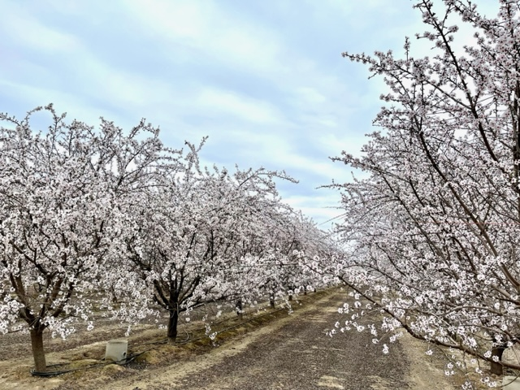
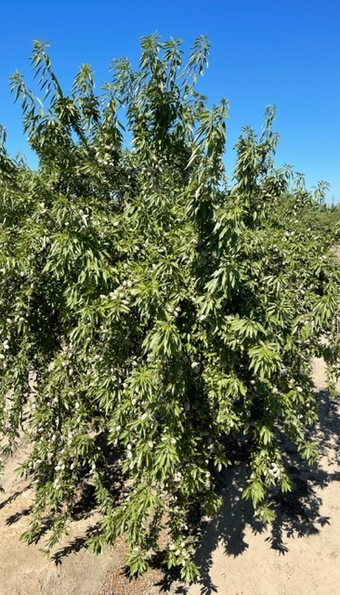
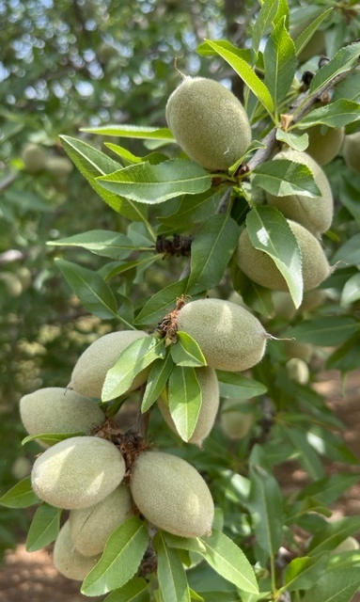

Slide 6
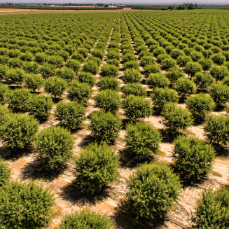

Almond Industry in CA
California produces 80% of the world's almonds and 100% of the United States commercial supply
In 2020, 1.25 million acres (5,100 km²) devoted to almond farming in California, producing 2.8 billion pounds (1.3 Mt).
Almonds are the state's most valuable export crop.
$4.9 billion worth exported to foreign countries in 2019, about 22% of the state's total agricultural exports, with the European Union, India and China as leading destinations.
https://en.wikipedia.org/wiki/Almonds_in_California

Slide 7
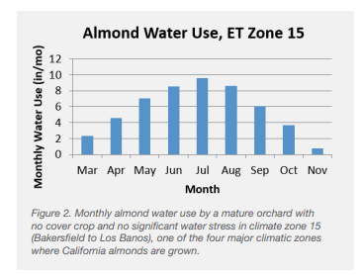
Mature Orchard Water Use
https://www.almonds.com/sites/default/files/2020-02/Almond-Irrigation-Improvement-Continuum.pdf

Slide 8
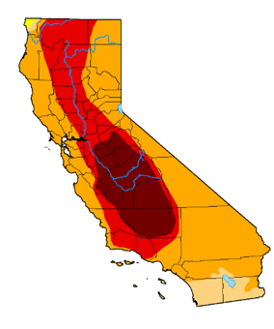
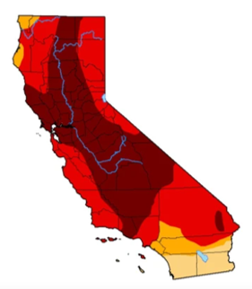
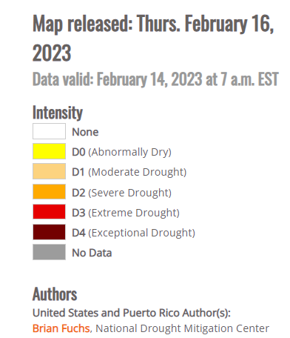
CA Drought
October 2021 September 2022
In 2021, due to a historic long-term drought in California, production was forecast to decline, and many almond orchards were being abandoned.

Slide 9
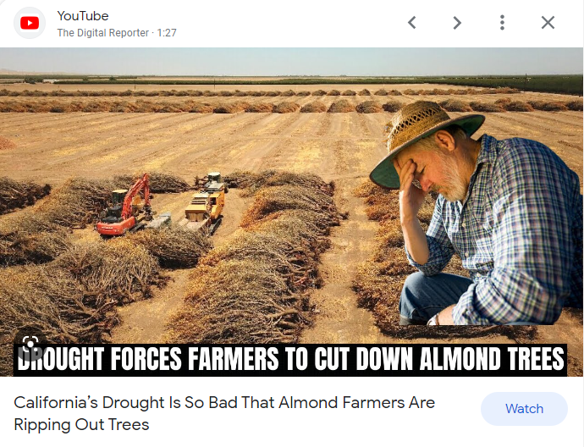
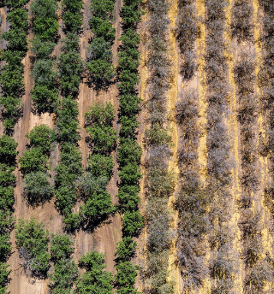

Slide 10
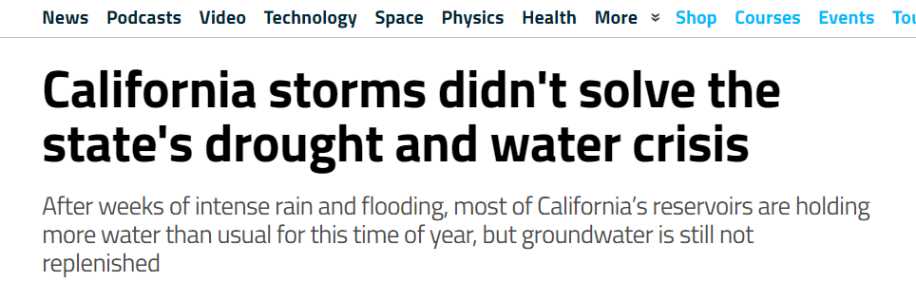
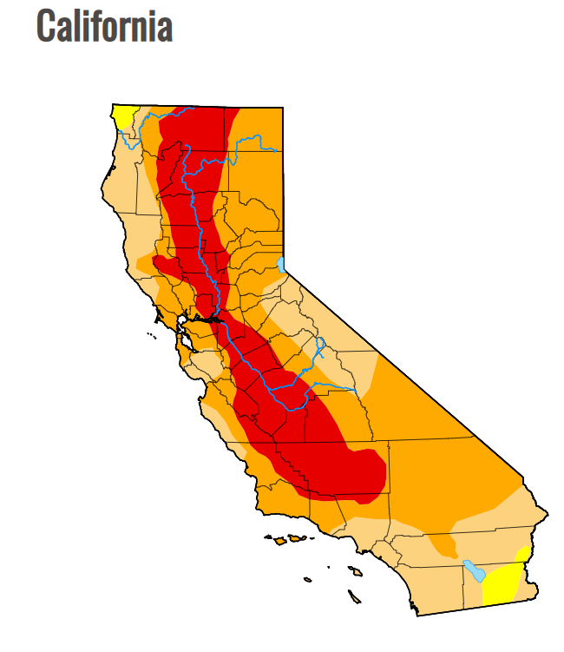
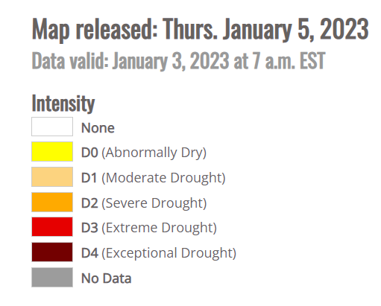
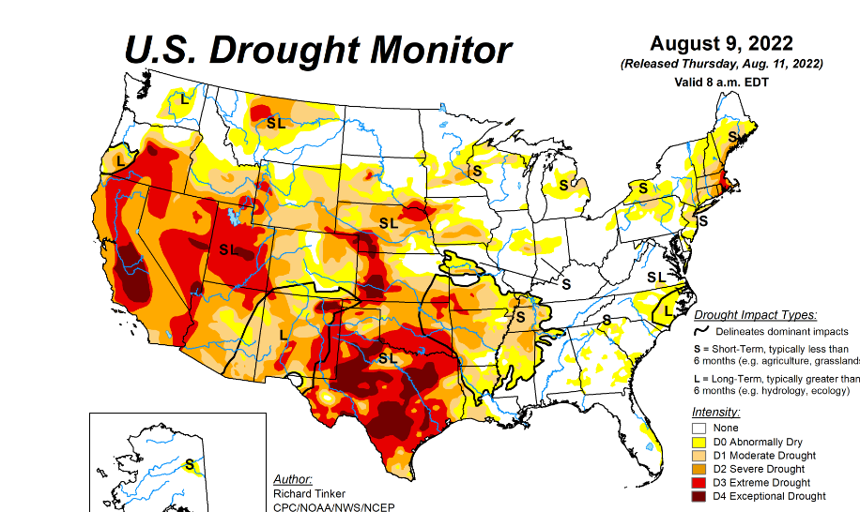
Drought - Abiotic Stress
Plant Water: 80–95% of the fresh biomass of the plant body is comprised of water
Various physiological processes including many aspects of plant growth, development, and metabolism
Reduced plant yield and quality or complete crop failure.
Contributes to soil salinity

Slide 11
Abiotic Stress: Heat Stress
Ideal temperature: 60 to 85ºF.
Each 18ºF increase from ideal growing temperatures doubles the respiration and water loss (general rule).
Thermal death threshold: 115ºF, varies plant to plant, duration at high temperatures, highest temperature reached, age of plant, water content within the plant, plants ability to acclimate, etc.
Hundreds of gallons of water is moved and lost in fully mature trees via transpiration in order to maintain lower plant temperatures. As much as 90% of water taken up via the roots.
Source: https://ucanr.edu/sites/MarinMG

Slide 12
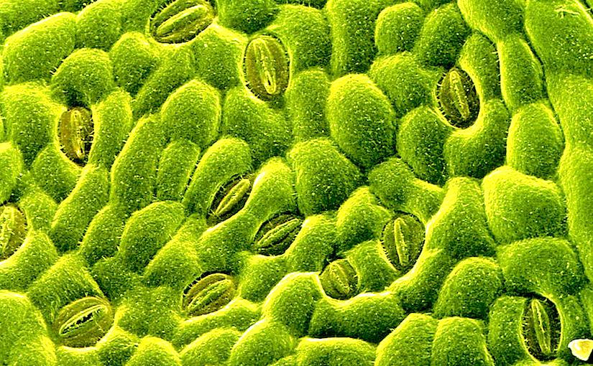
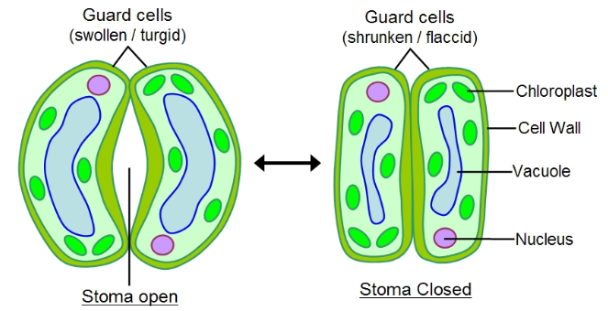
Stomata
When the plant has enough water in its cells the guard cells swell up and open the stomata.
When the plant isn't getting enough water, stomata stay closed plants don’t lose water. But if the stomata are closed photosynthesis can't happen and eventually the plant might starve.
The stomata (plural, stoma= singular) are openings on the bottom of leaves that allow for gas exchange and water from the plant tissue can evaporate through them.
Source: https://socratic.org/questions/how-do-stomata-help-conserve-water

Slide 13
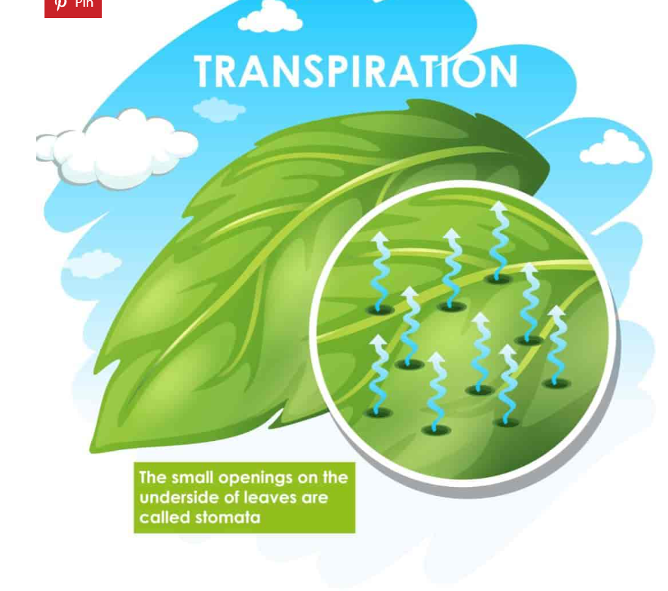

Transpiration
If the stomata are open all the time water from the plant will diffuse into the air based on humidity, basically if there is more water in the leaf than in the air, water will leave the leaf until the air around it has the same amount of water as in the leaf. So, if the air is dry the plant could lose a lot of water.
Moisture loss due to atmospheric evaporative demand.
Diagram source: https://plantcaretoday.com/what-is-transpiration.html

Slide 14
Vapor Gard
Anti-transpirant

Slide 15
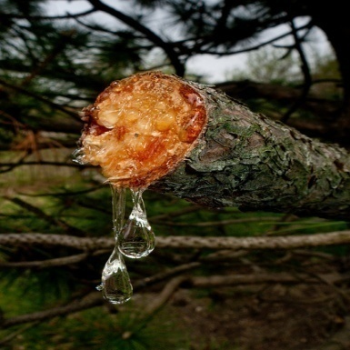


Natural terpene product that is extracted from conifers
Miller proprietary formulation is known as Pinolene terpene polymer.
Non-ionic and high-quality terpene polymer.

Slide 16

Pinolene Overview
A proprietary formulation and process that yields a high-quality form of terpene polymer
Conifer resin based
Polymerization
4 Phases
Deposition improvements
Plant and application protections
Plant “safety”
Notes:
4 Phases
Phase 1- “Liquid and Vapor Stage”
Phase 2- “Trapping Action”
Phase 3- “Dry Film-Luster Appearance”
Phase 4- “Powder Formation”

Slide 17

How it Works
Forms a soft, microscopic clear film over the leaf and plant surface.
The soft flexible film reduces moisture loss from transpiration and evaporation.
The soft-film polymer allows the movement of carbon dioxide (CO₂) and oxygen (O₂) into and out of plant.
The film does not interfere with photosynthesis and respiration.

Slide 18
California Field Trials
Demonstrate the benefits of Vapor Gard on tree, nut, and vine crops under drought conditions.

Slide 19
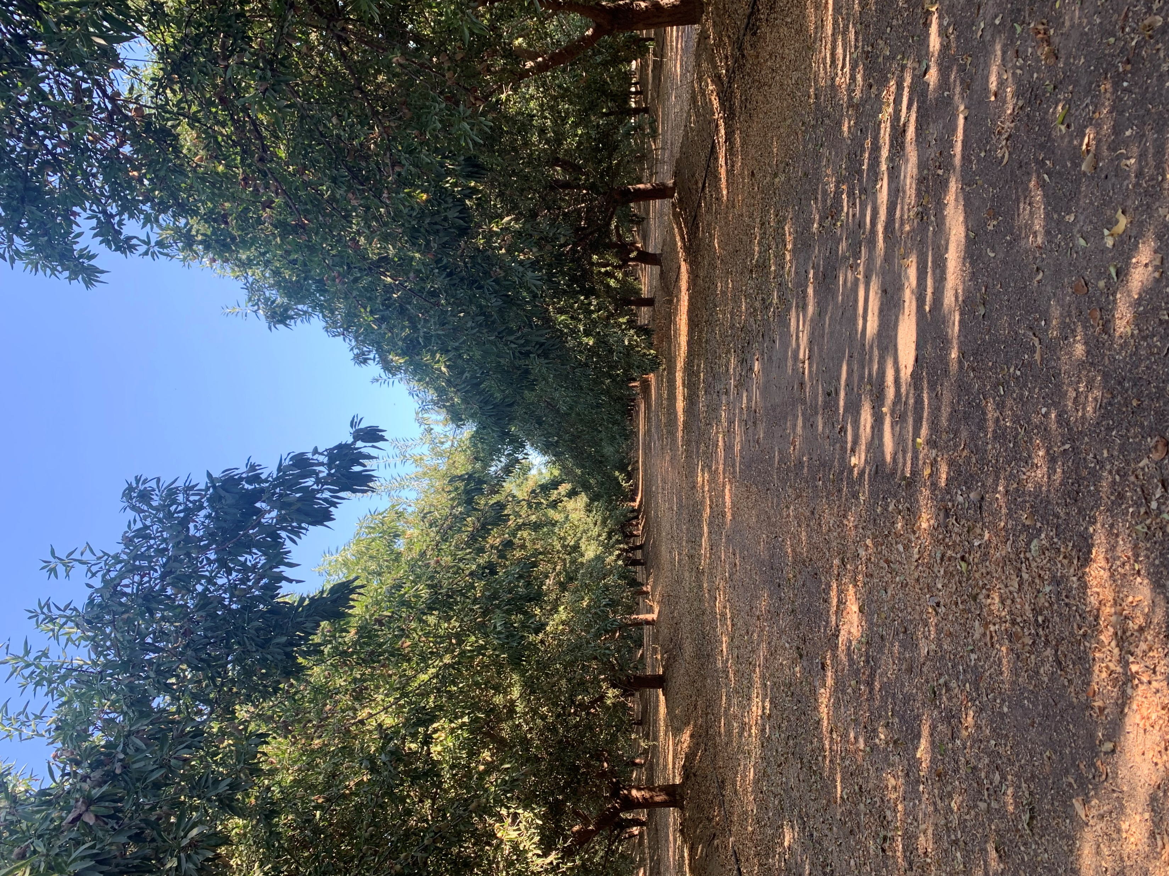
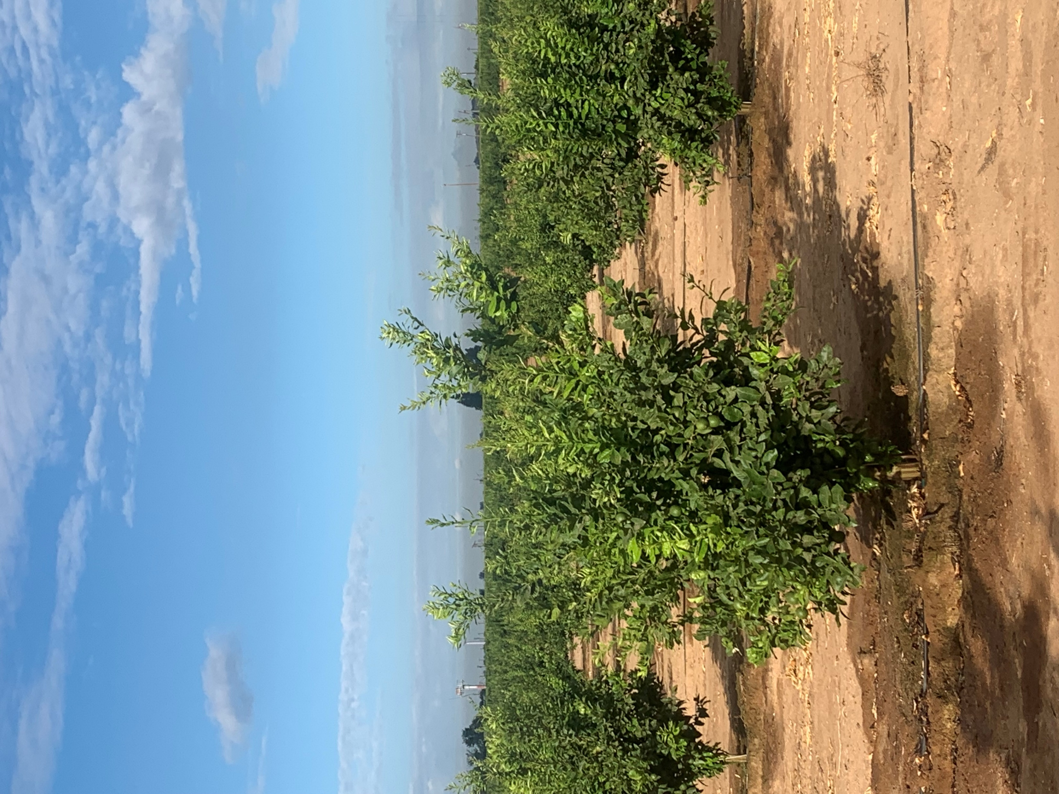
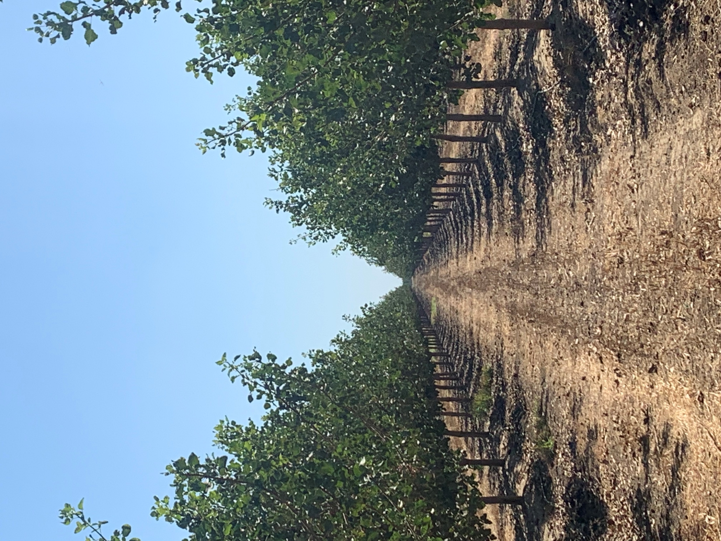
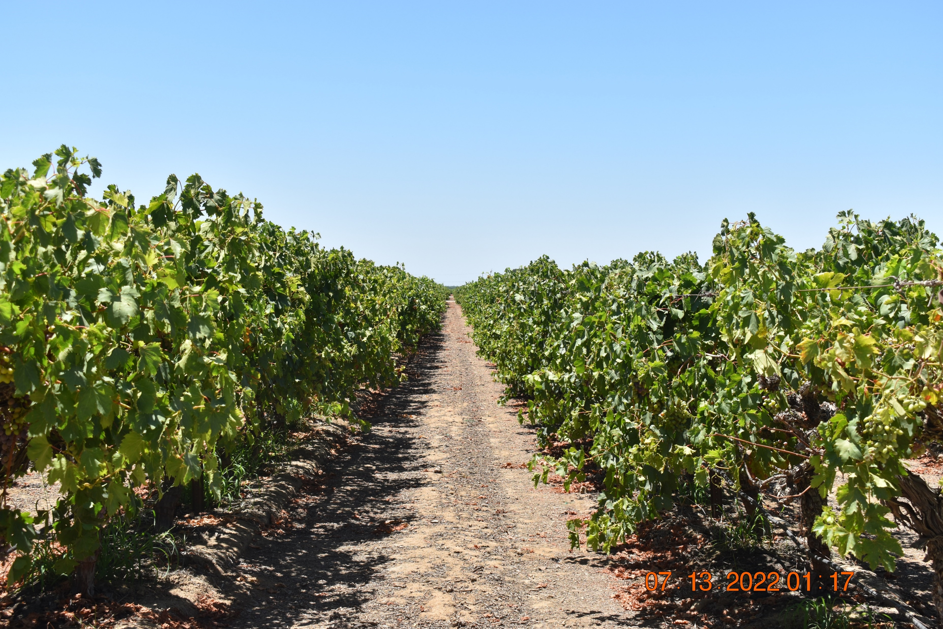
Table Grapes
Almonds
Lemons
Crops
Pistachios

Slide 20
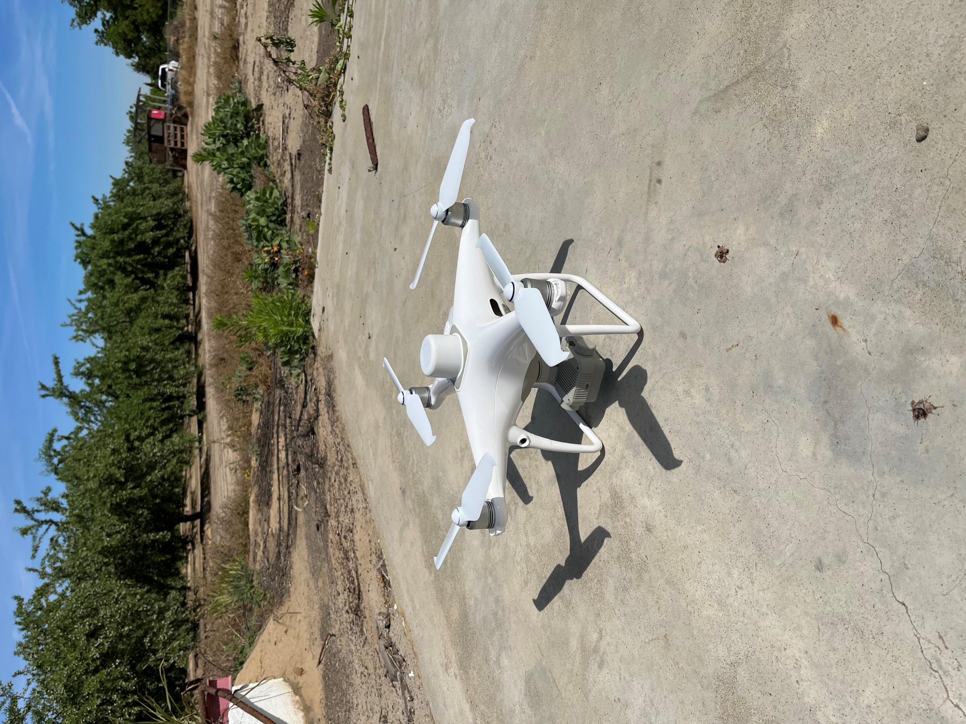
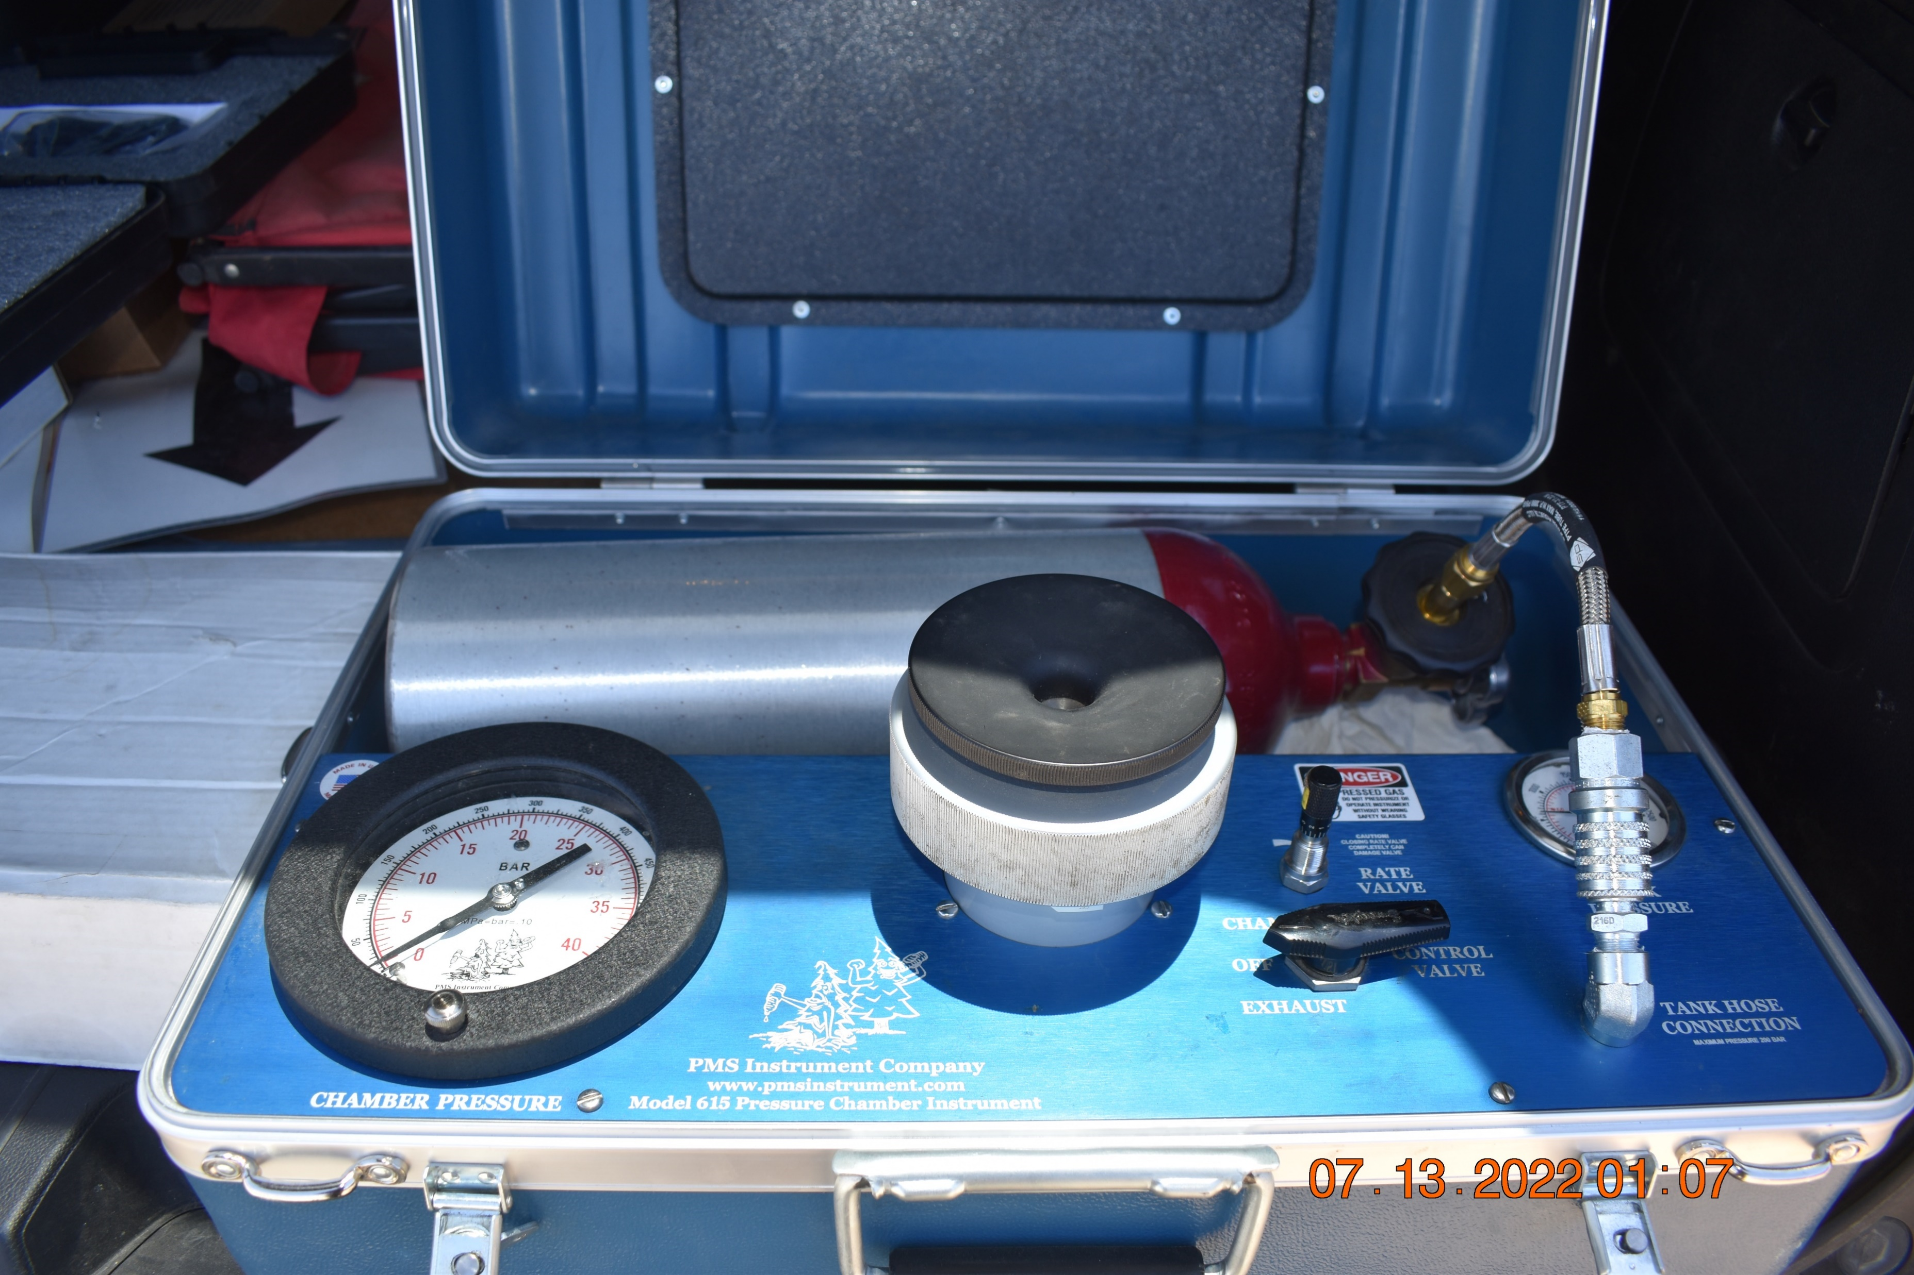
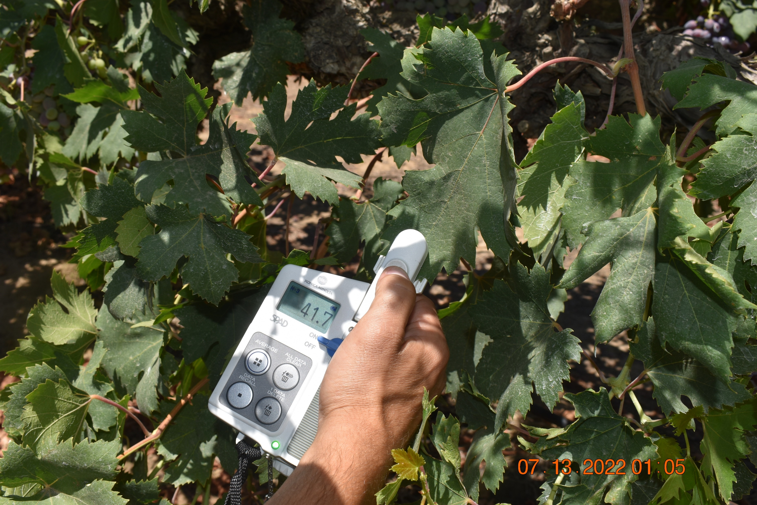
Data Collection
Drone (picture with NDVI)
Pressure Chamber Readings
SPAD Meter Readings

Slide 21
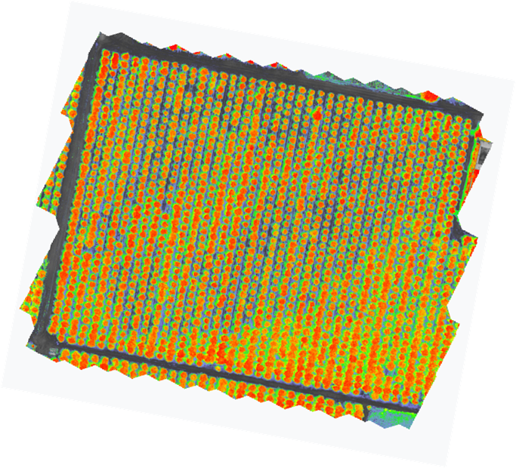
Drone:
Flown on a 7-day interval
Images collected for NDVI
(Normalized Difference
Vegetation Index)

Slide 22

Soil Plant Analysis Development (SPAD)
Rapid and non-destructive approach to measure chlorophyll content in the field.
Readings based on two transmissions:
  Red light at 650 nm, which is absorbed by chlorophyll
  Infrared light at 940 nm, which no chlorophyll absorption occurs

Slide 23
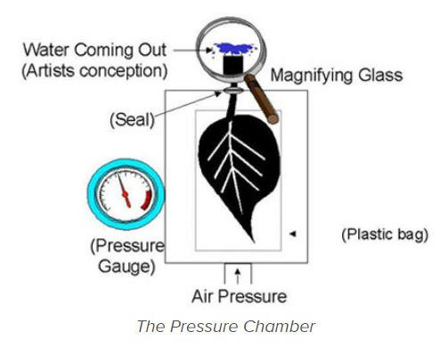
Pressure Chamber:
The amount of pressure that it takes to cause water to appear at the petiole indicates tension the leaf is experiencing on its water.
Translation:
  High pressure reading = Low plant water availability
  Low pressure reading = high plant water availability
Pressure units:
Bar (1 Bar = 14.5 pounds per square inch)
Mega Pascal (1 MPa = 10 bars).
https://fruitsandnuts.ucdavis.edu/pressure_chamber

Slide 24
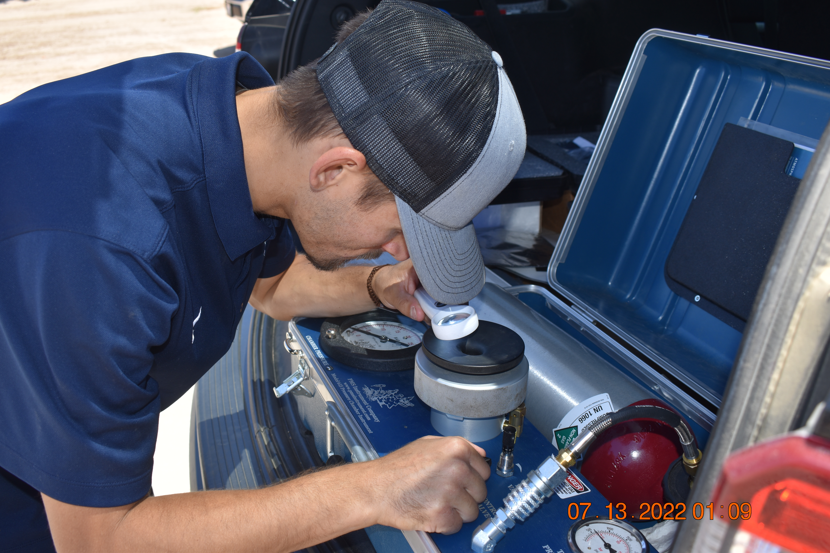
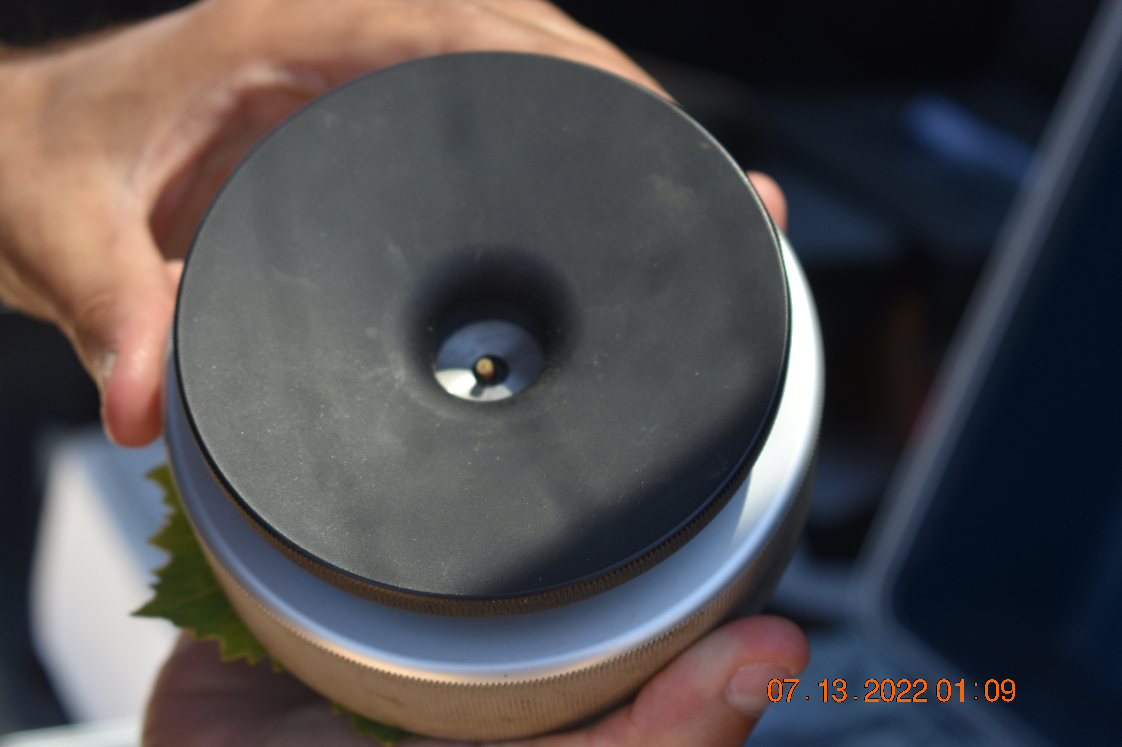
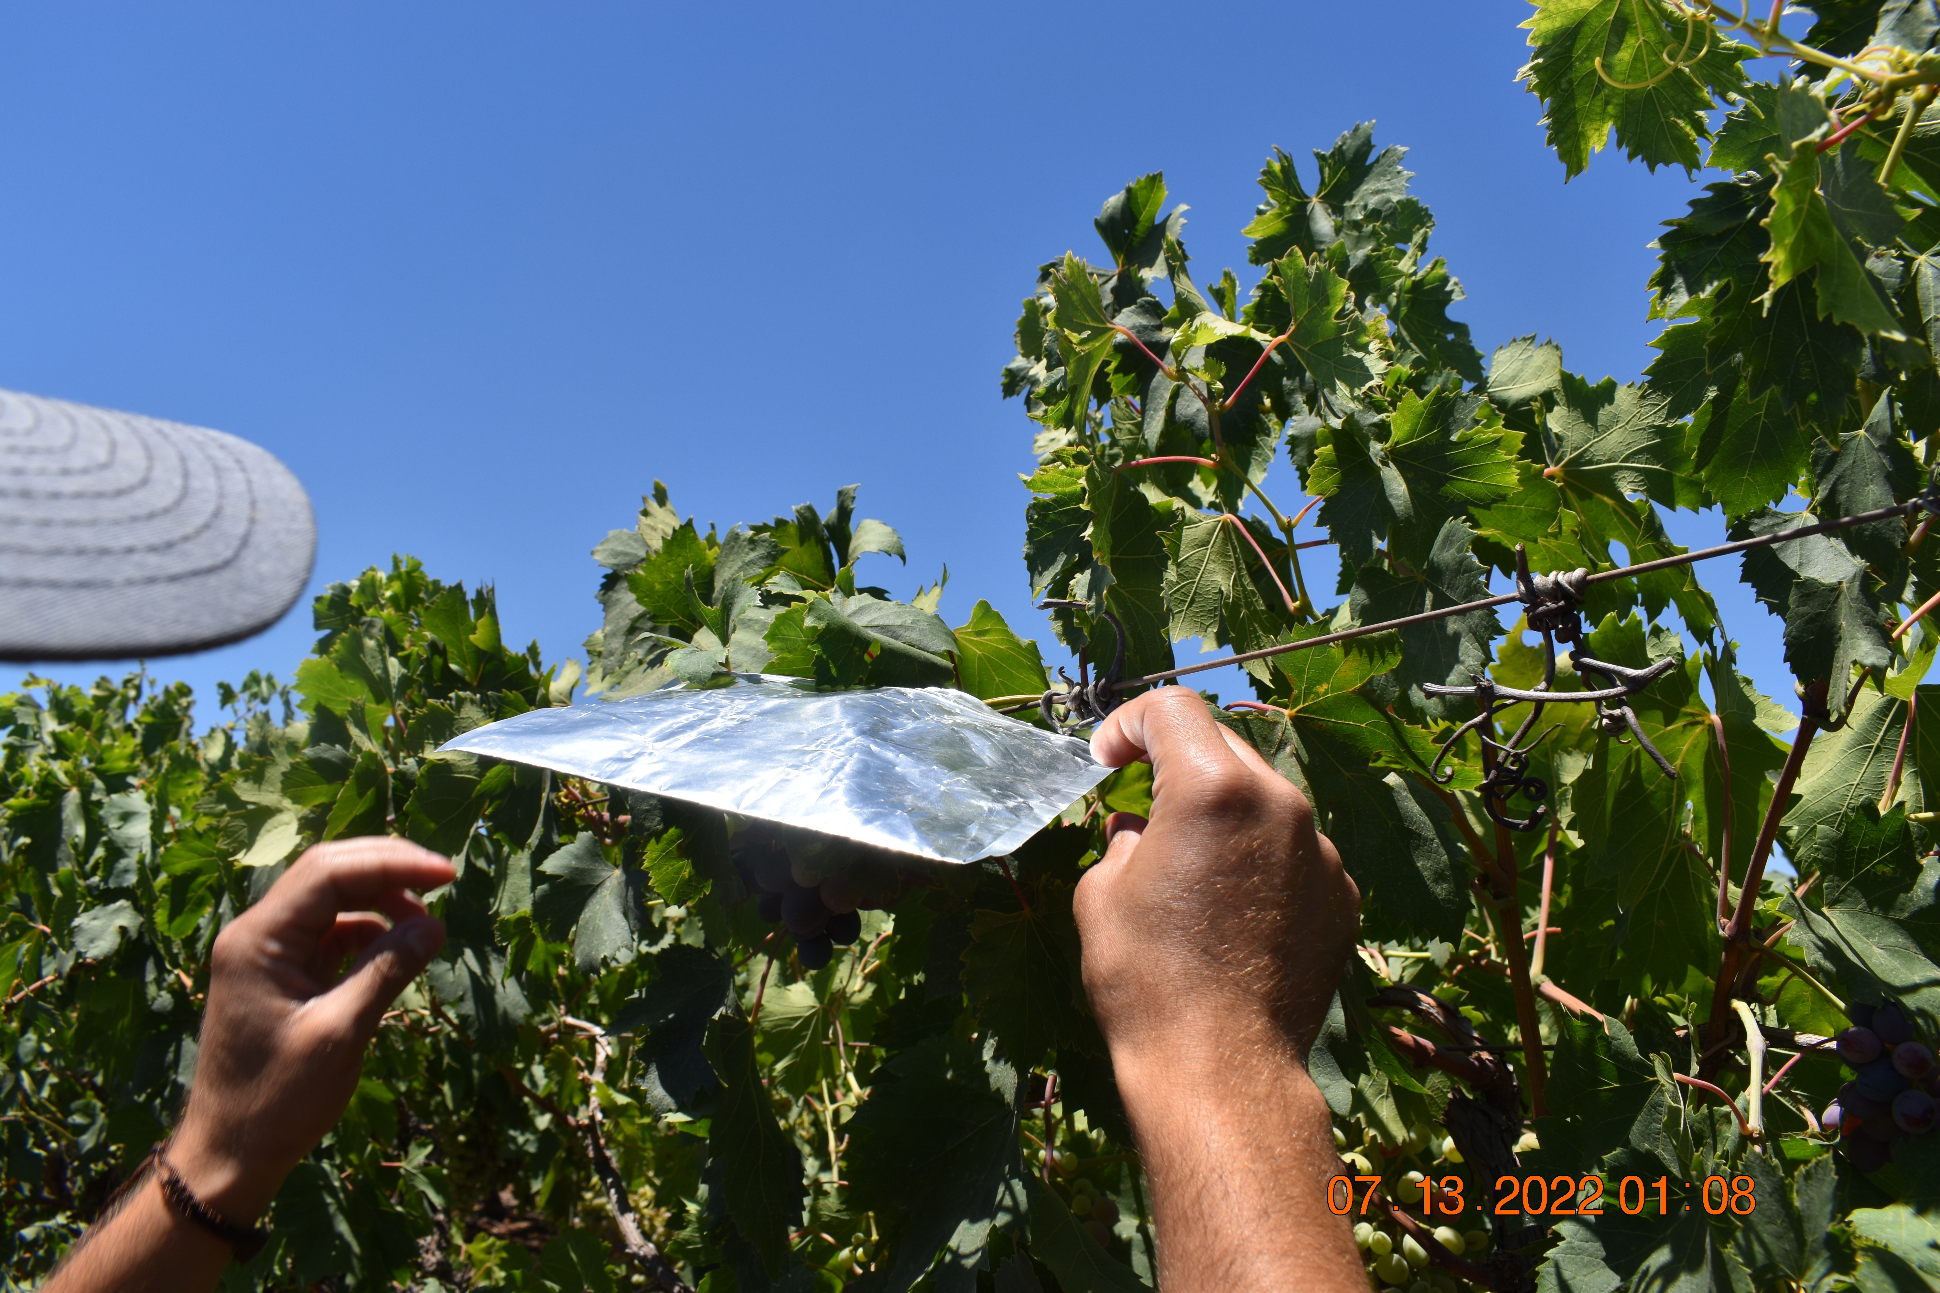

Slide 25
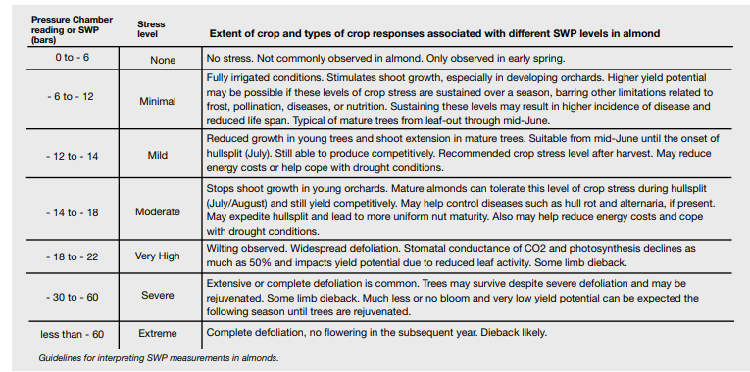
Interpreting Data: Almonds

Slide 26
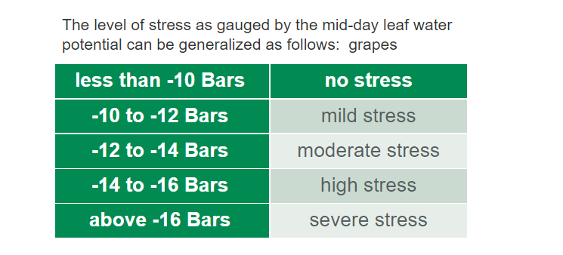
Interpreting Data: Grapes

Slide 27
Results

Slide 28
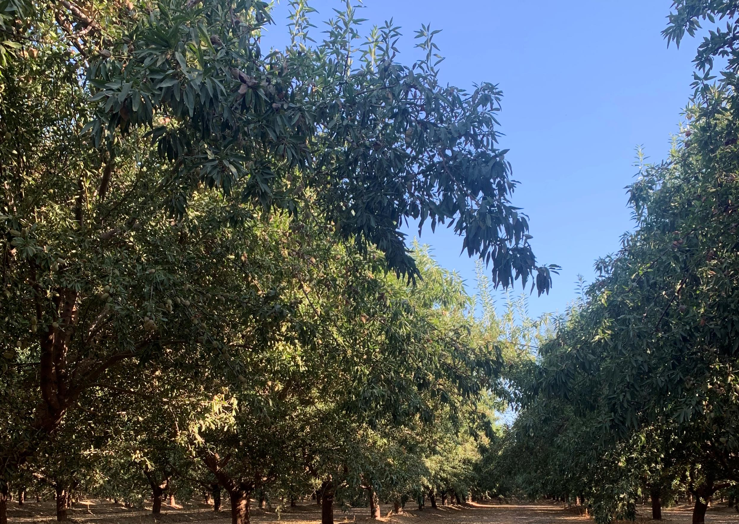
Almonds
Rootstock: Hansen
Variety: Shasta
Crop Age: 5 years

Slide 29
Pressure Chamber Readings – Almonds (Shasta)
Very High
High
Mild
Minimal
BARS
1st application: 20-June
2nd application: 2-Aug

Slide 30
SPAD Meter Readings – Almonds (Shasta)
Total Chlorophyll (µg/cm²)
1st application: 20-June
2nd application: 2-Aug

Slide 31
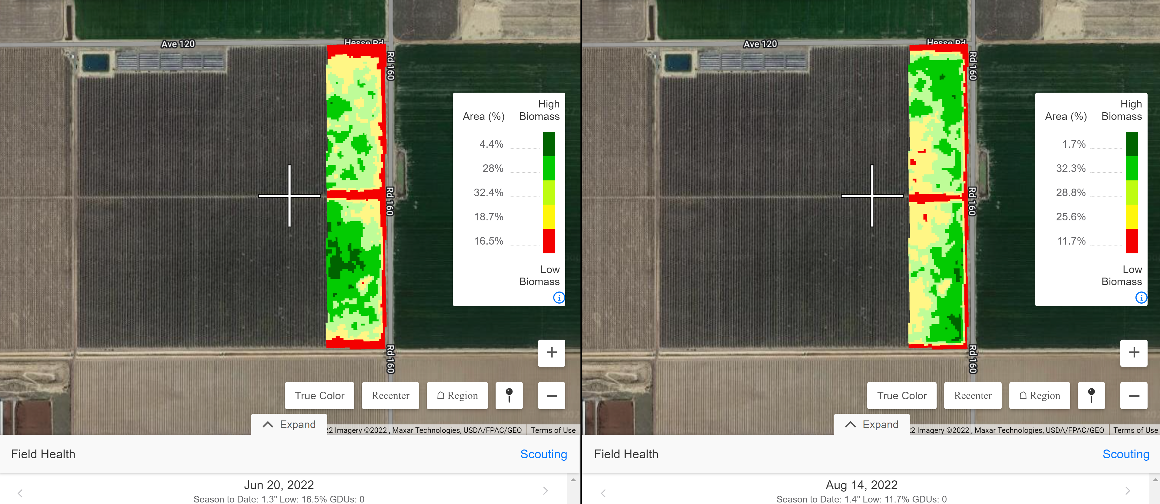
NDVI
Control
Vapor Gard
Notes:
June 20, Aug 2

Slide 32
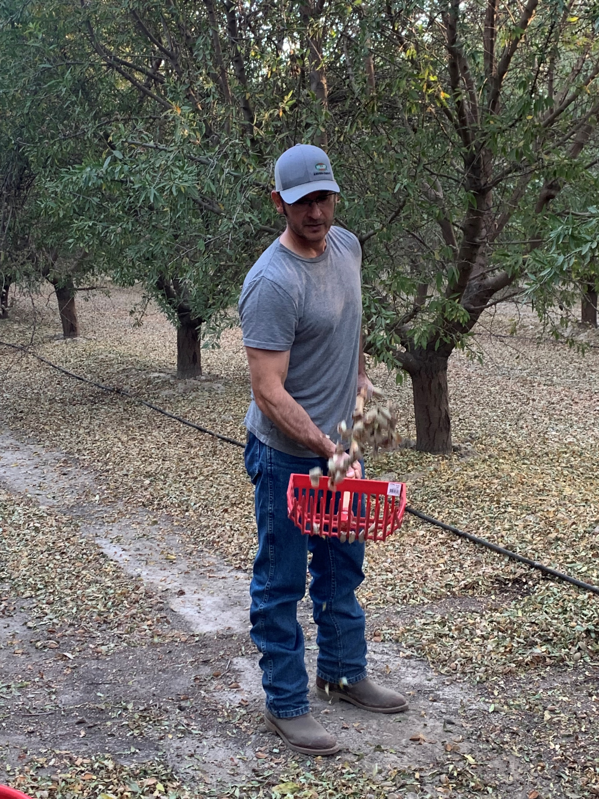
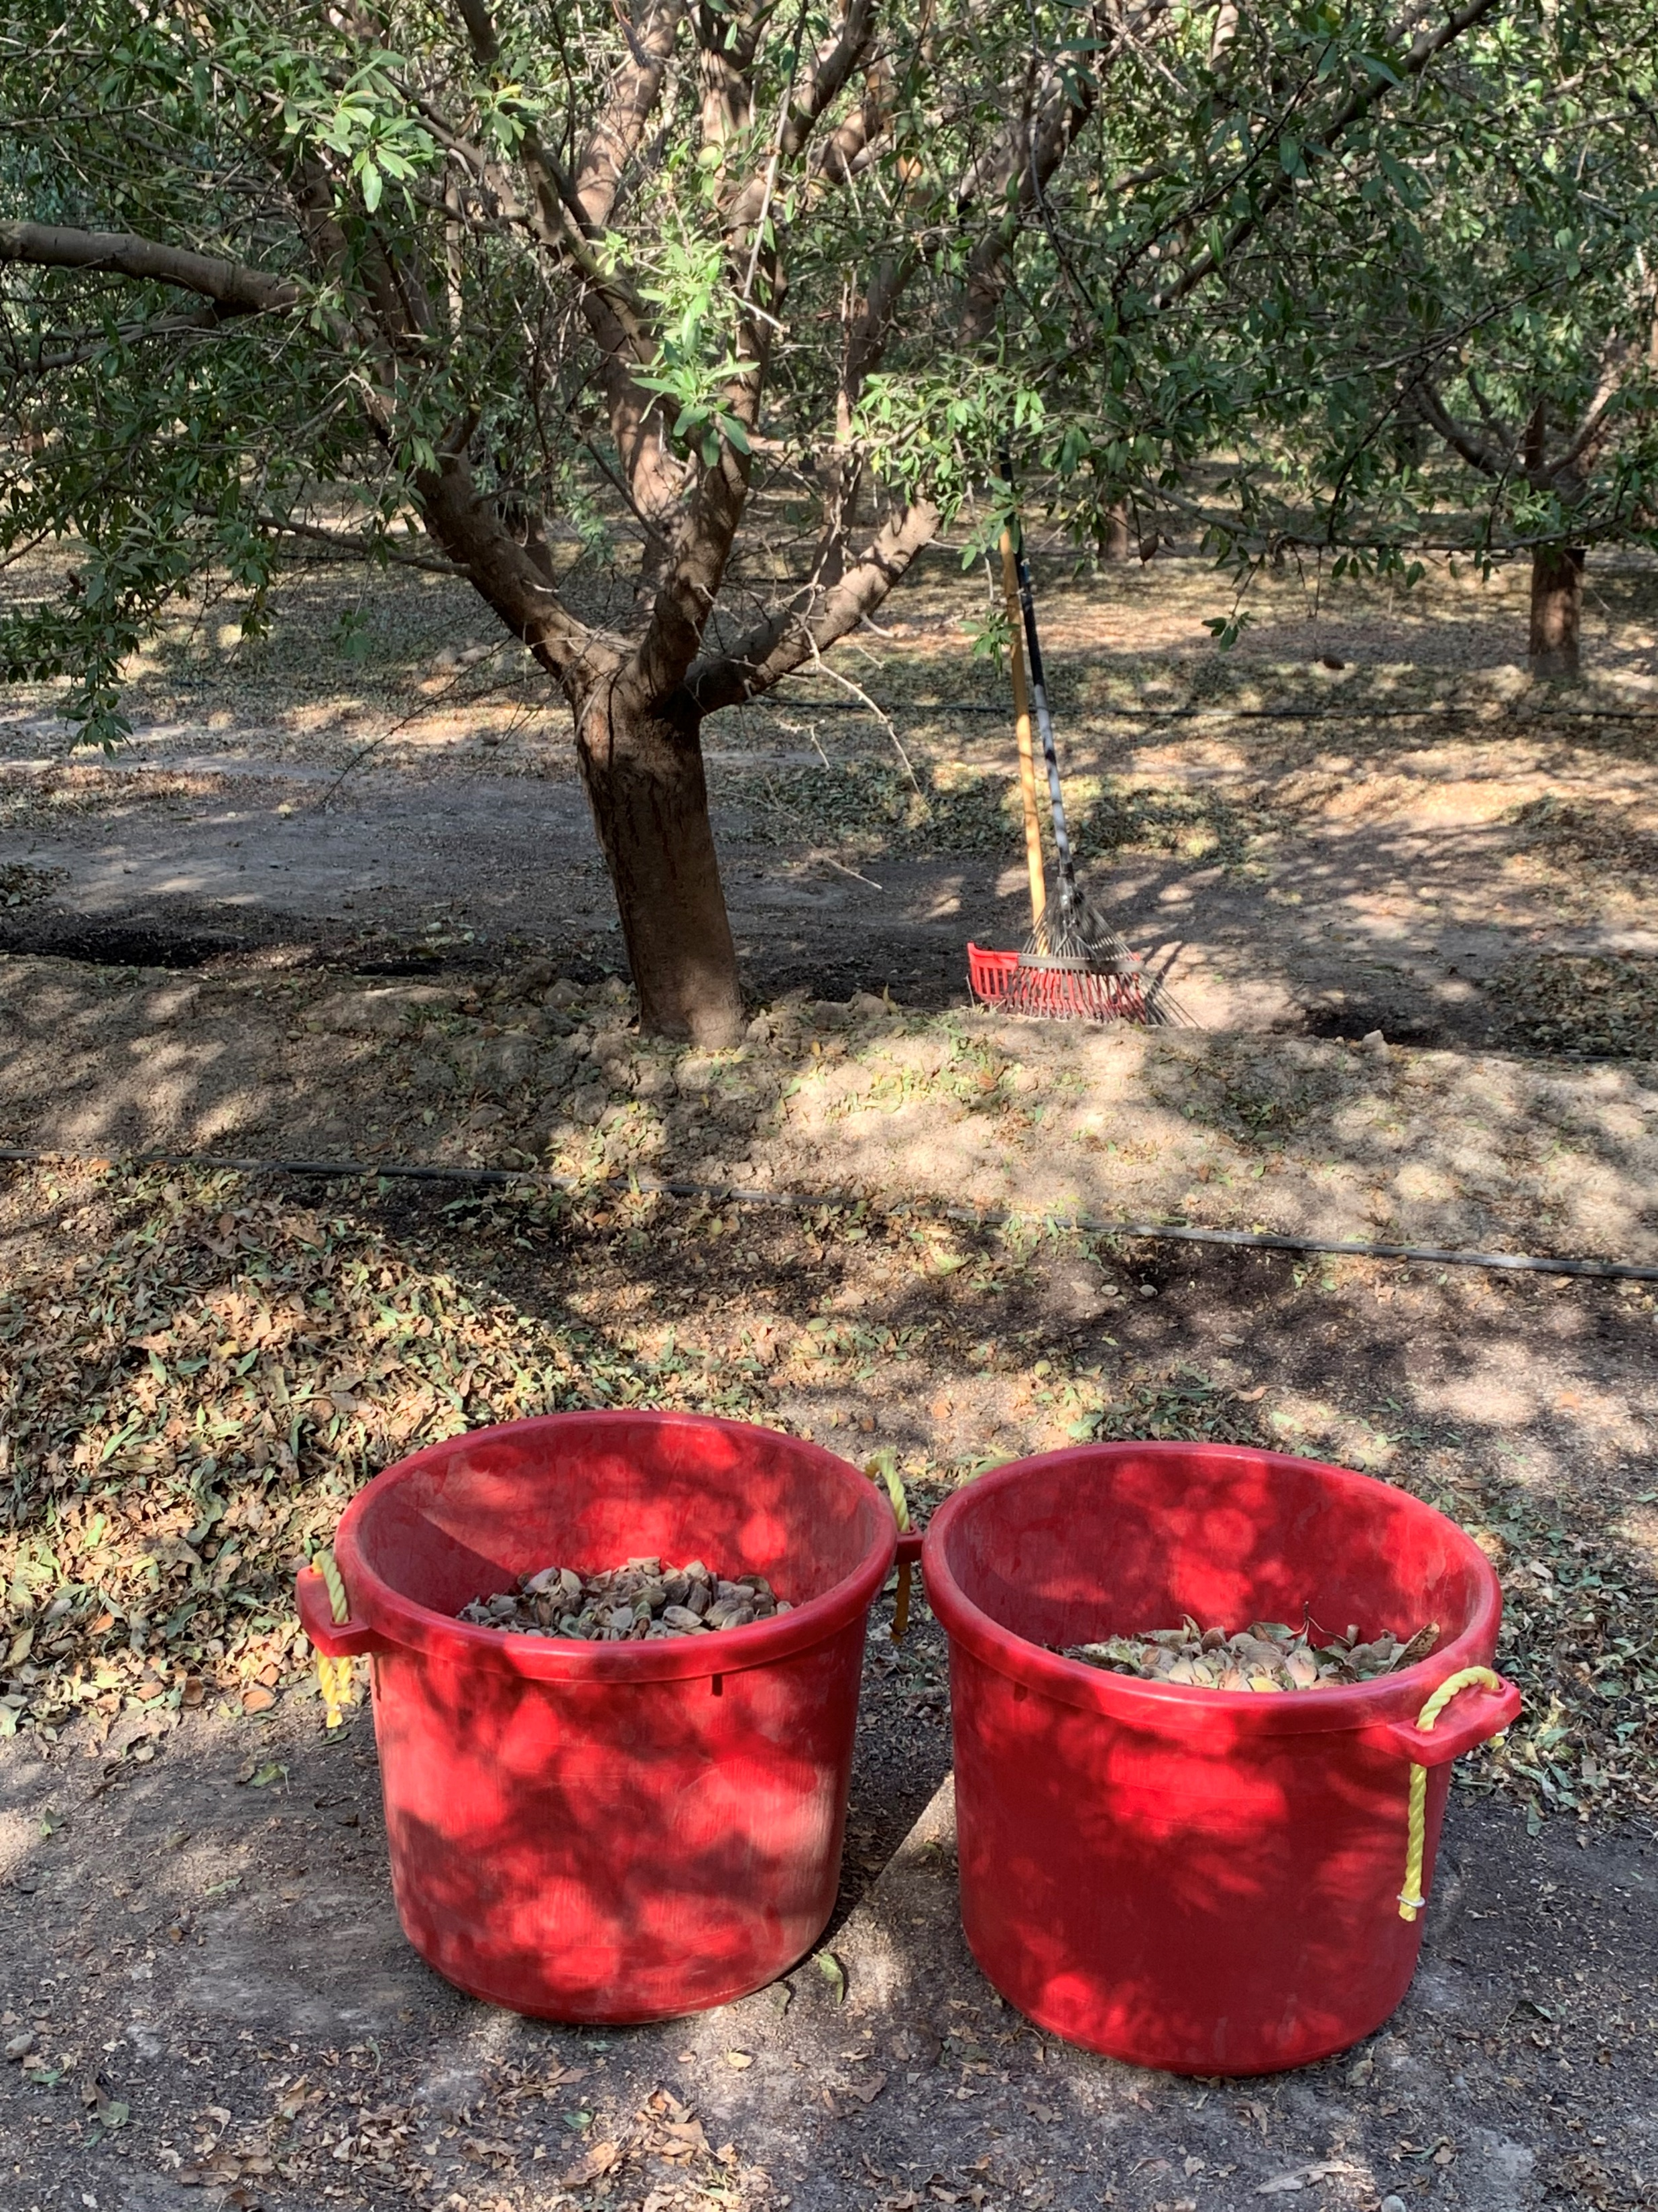
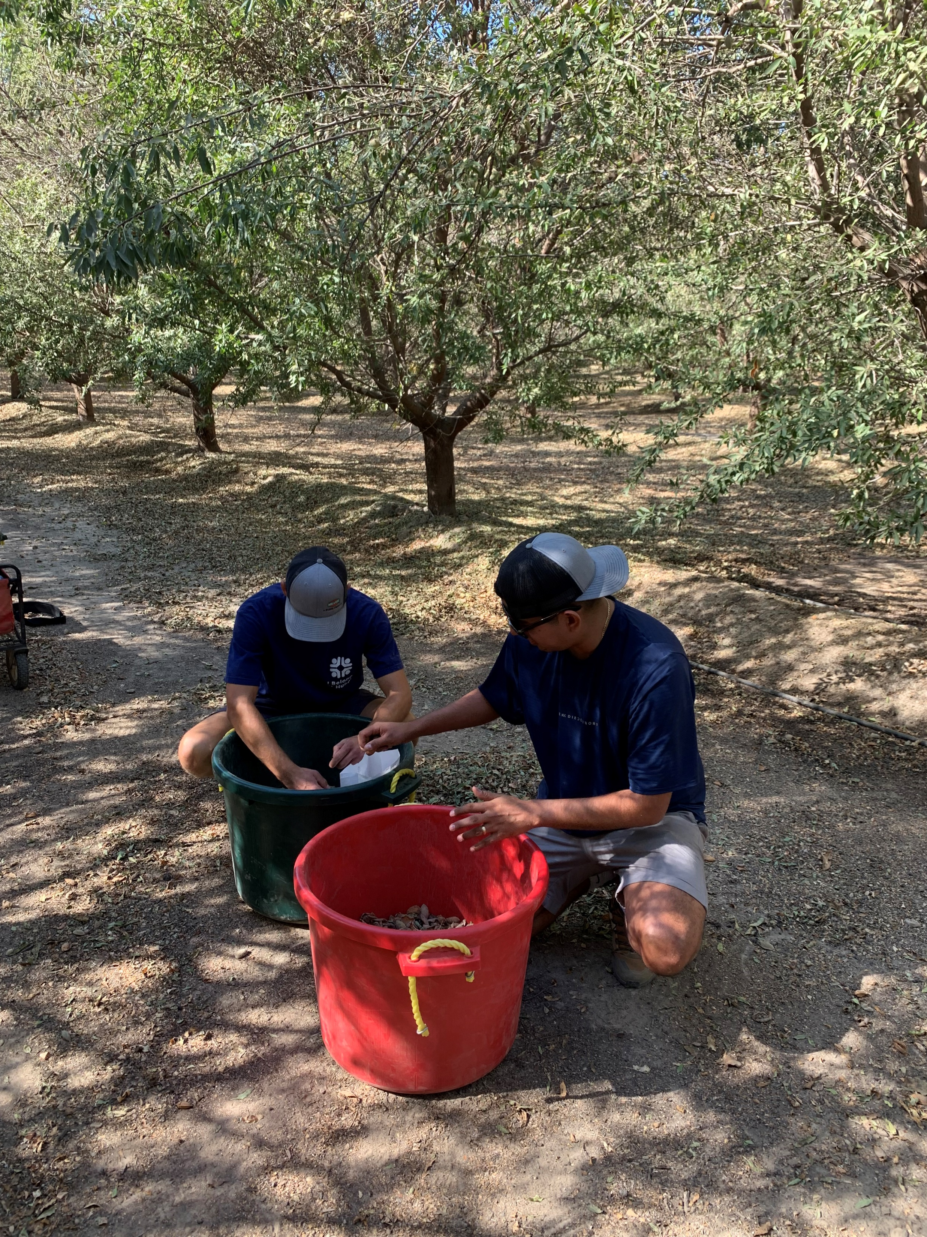
Harvest Data:
Notes:
Took 6 trees per plot and raked around the dimensions of the tree, into piles on each side of tree. Shoveled the almonds and shook as much almonds as we could, then dumped into 30 gallon container. Weighed each container with a field scale in pounds and collected 100 nut sample for data.

Slide 33
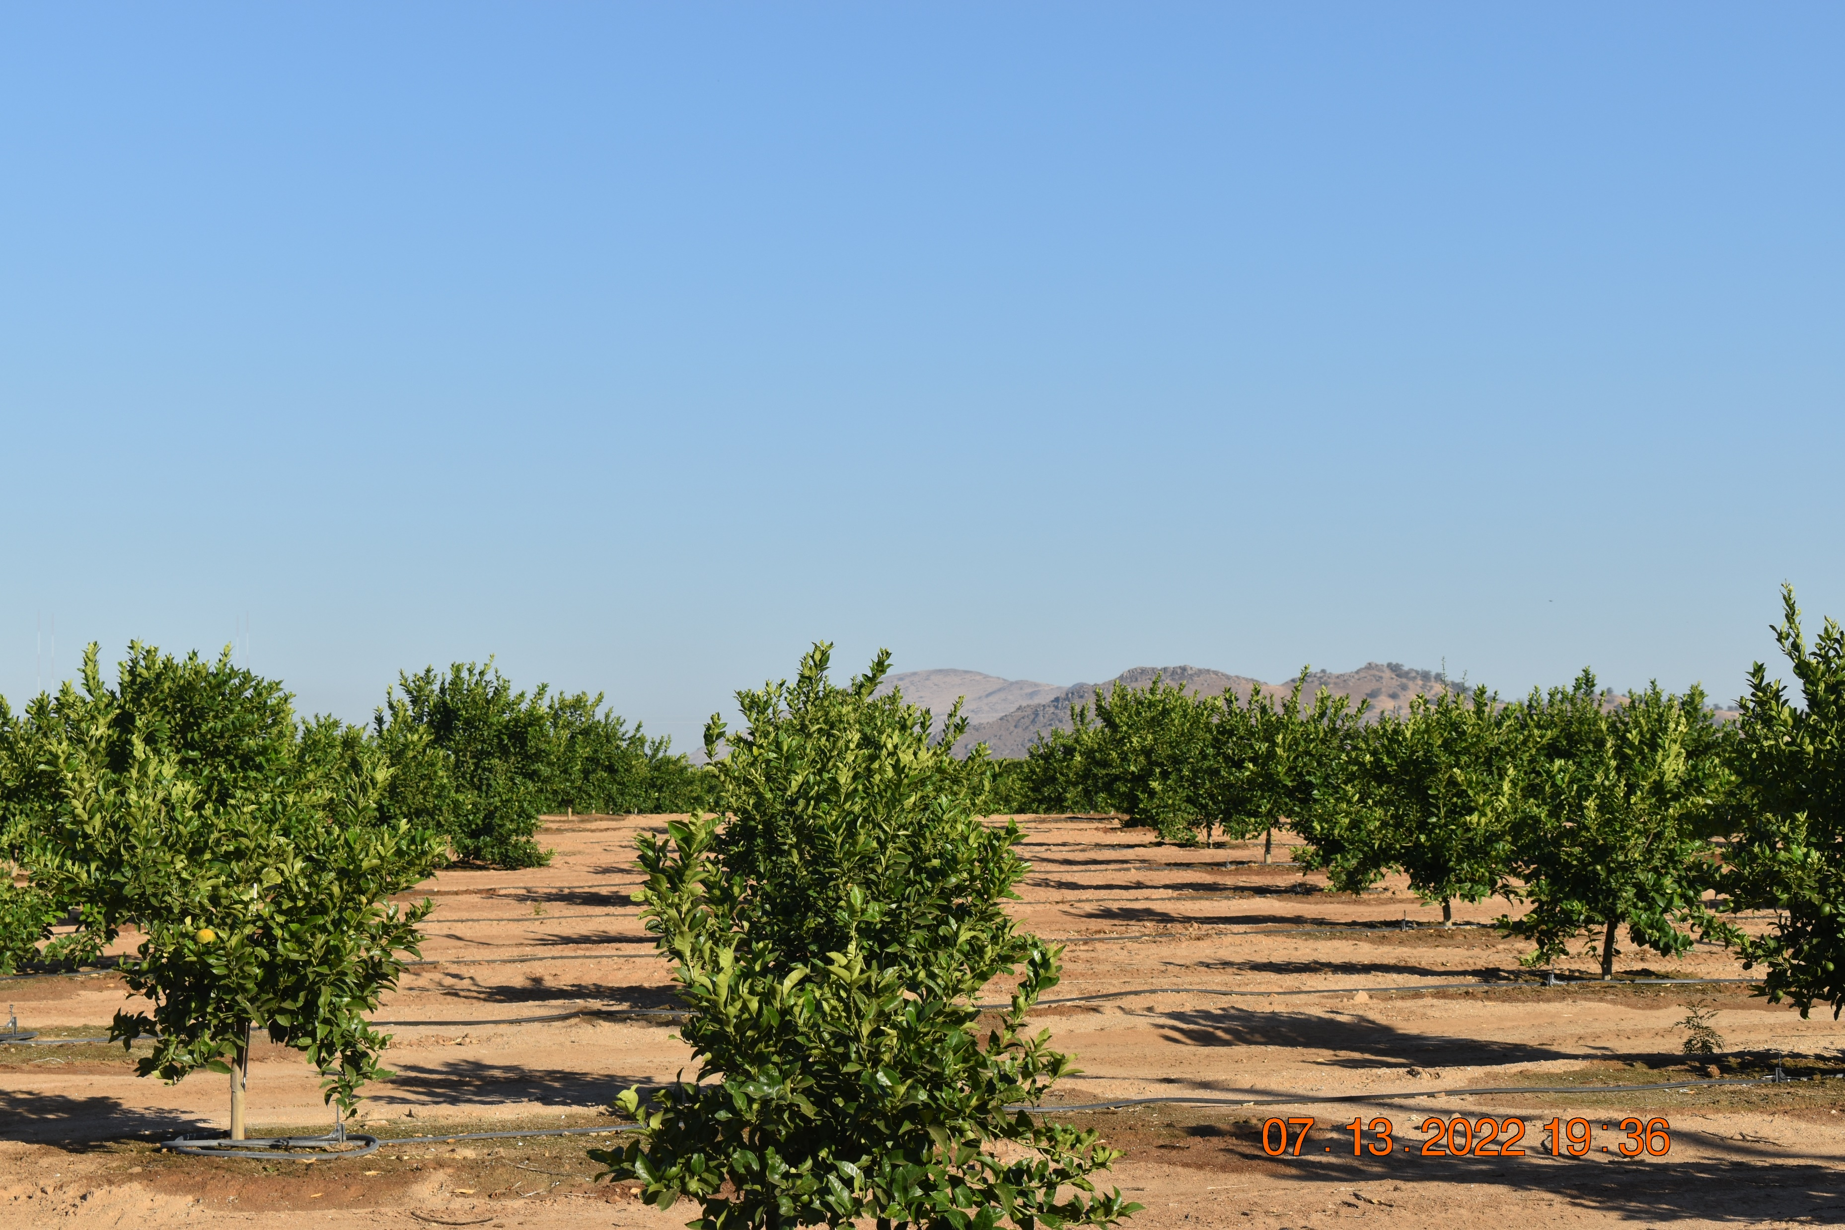
Lemons
Rootstock: Carrizo
Variety: Lisbon
Crop Age: 2 years

Slide 34
Pressure Chamber Readings – Lemons (Lisbon)
High
Mild
Minimal
BARS
1st application: 20-May
2nd application: 23-June
3rd application: 27-July
Notes:
May 20, June 23, July 27

Slide 35
SPAD Meter Readings – Lemons (Lisbon)
Total Chlorophyll (µg/cm²)
1st application: 20-May
2nd application: 23-June
3rd application: 27-July

Slide 36
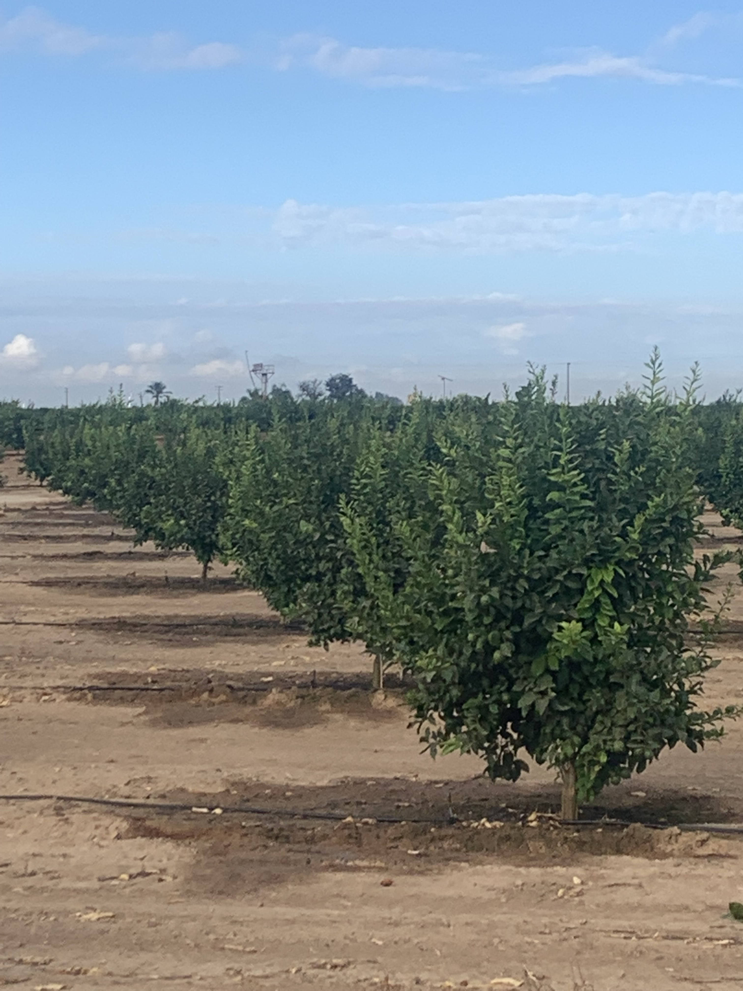
Vapor Gard
Lemons
Control

Slide 37
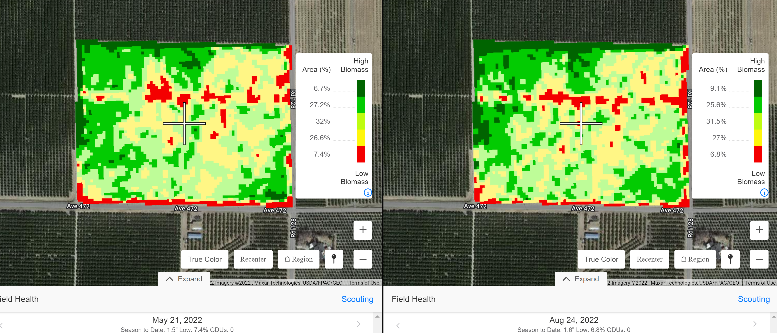
NDVI
Vapor Gard
Control
Notes:
May 20, June 23, July 27

Slide 38
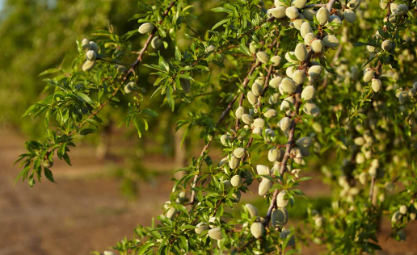
Almond Research Trial – Deficit Irrigation
Treatment | Treatment Name | Vapor Gard Rate/Applic | Appl Code | Appl Description | Spray Vol
1 | 100% Irrigation – 100C | --- | ABCD | A=Nut Fill (April), B=1 month (May), C=2 month (June), D=3 month (July) | 100 GAL
2 | 100% Irrigation + Vapor Gard (100VG) | 1 GAL/A | ABCD | A=Nut Fill (April), B=1 month (May), C=2 month (June), D=3 month (July) | 100 GAL
3 | 75% Irrigation – 75C | --- | ABCD | A=Nut Fill (April), B=1 month (May), C=2 month (June), D=3 month (July) | 100 GAL
4 | 75% Irrigation + Vapor Gard (75VG) | 1 GAL/A | ABCD | A=Nut Fill (April), B=1 month (May), C=2 month (June), D=3 month (July) | 100 GAL

Slide 39
Yield response
Vapor Gard improved almond yields by 395 lbs/acre at either 100 and 75% irrigation.
Similar yields at 75% irrigation with Vapor Gard (75VG) and 100% irrigation without Vapor Gard (100C).
+395 lbs/ac

Slide 40
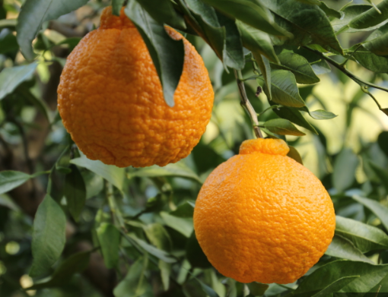
Vapor Gard on Sumo Mandarins
Treatment | Product | VG Rate/App | Irrigation | Timing
1 | Untreated (100C) | --- | 100% | As needed
2 | Untreated (75C) | --- | 75% | Follow schedule of Treatment #1 but at 75% rate irrigation
3 | Vapor Gard (100VG) | 1 gallon | 100% | Follow irrigation of Treatment 1 and apply 1 gal approximately 2-4 weeks before harvest
4 | Vapor Gard (75VG) | 1 gallon | 75% | Follow irrigation rate of Treatment #2 (75%) and apply 1 gal VG approximately 2-4 weeks before harvest

Slide 41
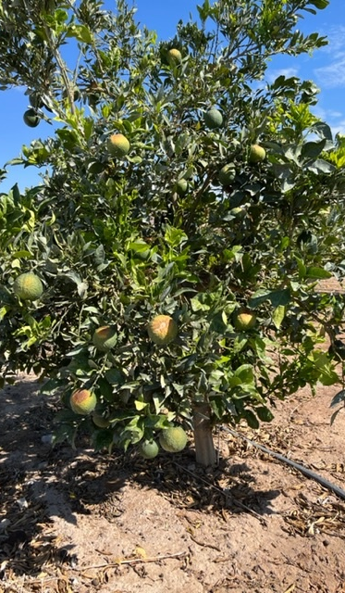
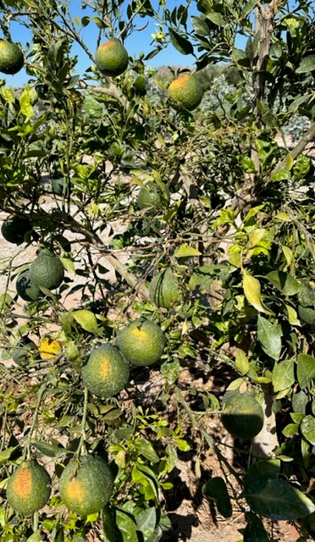
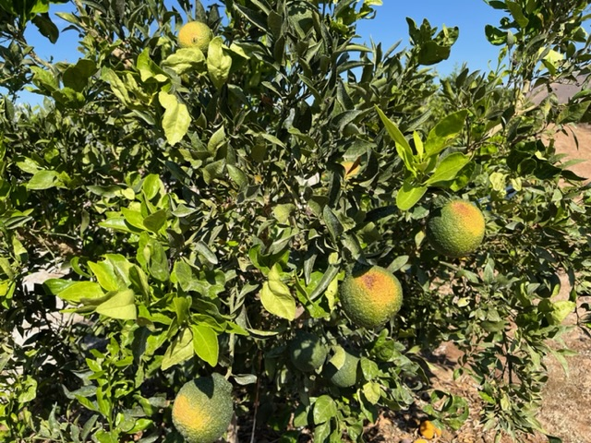
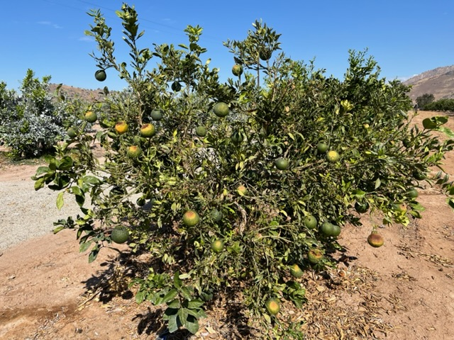

Slide 42
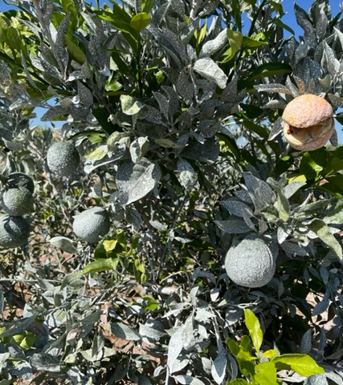
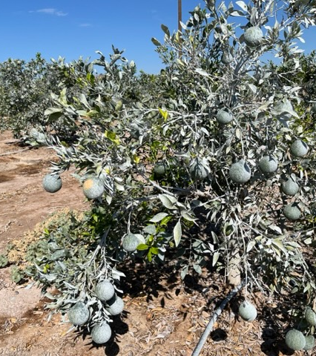

Slide 43
Heavy rains in late December and early January were devastating to the sumo crop.
Although Vapor Gard did not show any reduction in sunburn damaged fruit when compared with the untreated, VG trees had lesser fruits with disease (rind breakdown).

Slide 44
VaporGard applied in the Fall showed 30% increase in marketable fruit when evaluated in January.
Vapor Gard treated trees on average showed 500 lb/A increase in marketable fruit when compared with untreated fruit.
a

Slide 45

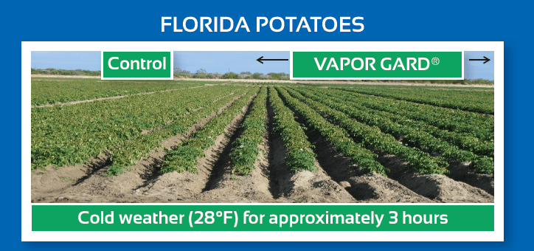
Best to have a specific approach
Application Methods
  Foliar - coverage is key
  Foliar rates - depends on water volume and crop
  One hour rain fastness
  Always follow the label
Notes:
One application method does not solve all intentions
Must have a program approach
Application Methods
Spray foliar or use as a dip (Do not Dip Roots) (Transplants)
Coverage is key
Foliar Rates- 1-2 gallons per acre depending on water volume and crop
Dipping Rates- 1 part to 40-50 parts of water
PHI- Depending on crop is 14 days
Allow one hour before dark or rain event to allow product to dry
Newly Released Supplemental Label allows Tank Mixing Pesticides up to 4 weeks before harvest
Always follow the Label

Slide 46
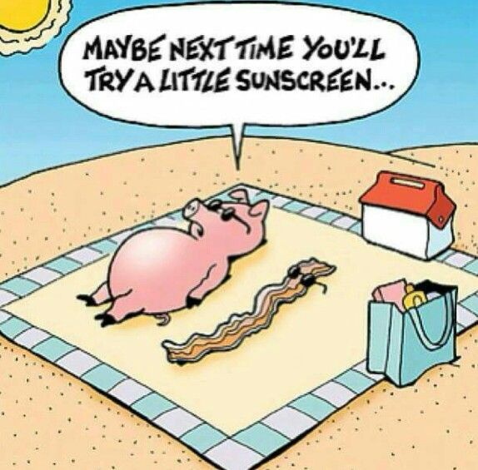
Vapor Gard Review
Wide Range of Crops
Flexible Uses
Reduced overall plant stress
Anti-transpirant/Anti-Desiccant
Notes:
The preservation of moisture leads to numerous benefits
Can be applied on a variety of crops for various intended uses
Potential reduction of irrigation needs
Reduced overall plant stress
Increased color, size, quality and flavor
Reduces splitting, rind rash, peel desiccation and increases storage life
Increases in chlorophyll,

Slide 47
Questions?

Slide 48
Thank you!

Slide 49



